Slide 1
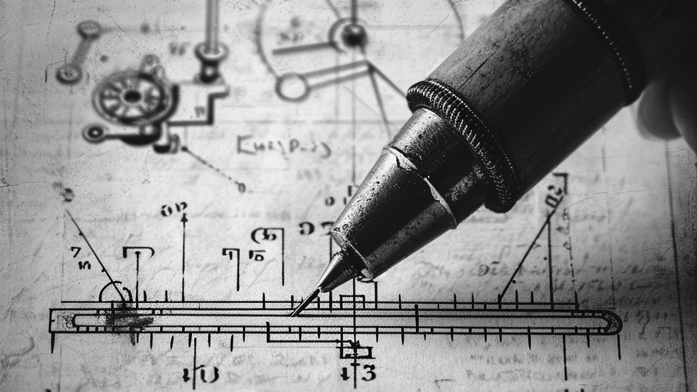
ENGR181W: Essay 2
ENGR181W
Spring 2026
Jovana Isevski
The University Writing Program

Slide 2
Announcement from the Professor
Since Canvas is down, Essay 1 deadline is extended to
Saturday 8:00 PM.
• If by that time (Saturday 5/9) Canvas is functional,
upload your essay there.
• If Canvas still is down by Saturday, send your
essay as an attachment to theidar@ucr.edu by 8:00 PM,
Saturday 5/9.
• Essays submitted or uploaded after 8:00 PM on
Saturday (5/9) will not be accepted.

Slide 3
What’s something in your field that didn’t exist 5–10 years ago?

Slide 4
Essay 2 Prompt
Discuss the contemporary engineering issues related to the project. Potential contemporary engineering issues related to your project include:
new technologies
new industry standards
new design methods
new materials
new trends in manufacturing, etc.
Discuss how doing this design project helped you (a) recognize the need, and (b) develop the ability in lifelong learning.

Slide 5
Essay 2 Prompt
Examples:
One trend in electronics is high-level integration and very low-power consumption requirement; how is that related to your project?
Another example is Internet-dependent distributed real-time sensing; how does your project fit with that trend?
Other examples of contemporary engineering issues include AI, quantum mechanics, cloud computing, broadband wireless data becoming more widespread, renewable energy, natural resources becoming increasingly limited, population becoming old and needing more care, Internet security threats are increasing, etc.
This essay is NOT about ethics again.
It’s about:
What trends your project is part of
Why engineers need to keep learning

Slide 6
Group Brainstorming
What new technology/trend is your project part of?
Why is this trend important right now?
How does your project connect to it?
What responsibility does this create for engineers?
You’ll discuss this in groups, but each person must identify their own issue.

Slide 7
Lifelong Learning
Lifelong learning = engineers constantly need to learn new tools, technologies, and knowledge because things change.
What did you have to learn for your project that you didn’t know before?
You’re not quite done learning once you’ve built your product. If yours became a real product or career-level project, what new knowledge would you still need to develop?

Slide 8
Wrap-up:
My contemporary issue: ______
Why it matters: ______
What I had to learn: ______

